Slide 1

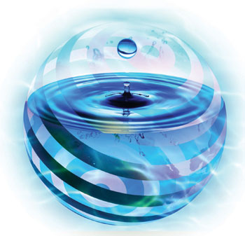




BOD-DO Model

Slide 2


5.1 Biochemical Oxygen Demand (BOD)
BOD measures O₂ consumed by microorganisms;
In decomposing (in)organic matter in water;
Wastewater from sewage treatment plants;
⇒ organic materials decomposition, − O₂;
Chemical oxidation of inorganic matter;
⇒ extraction of O₂ via chemical reaction;
Common, environmental parameter;
Measures the extent to which oxygen within a sample can support microbial life.

Slide 3
5.1 Biochemical Oxygen Demand (BOD)
Test: Measure O₂ consumed during a specified period of time (5 days at 20 °C);
Rate of O₂ consumption is affected by
Temperature, pH, microorganisms presence, and organic and inorganic material type.
BOD directly affects DO in rivers and streams;
↑ BOD, more rapid oxygen depletion;
⇒ < O₂ is available to aquatic life.

Slide 4
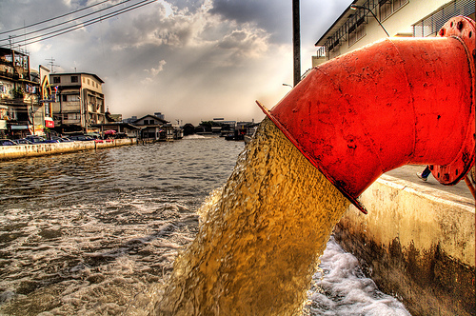
5.1 Biochemical Oxygen Demand (BOD)
Consequences of high BOD = low DO:
aquatic organisms stressed, suffocate, and die.
Sources of BOD:
leaves and woody debris;
dead plants and animals;
animal manure;
effluents from pulp and paper mills, wastewater treatment plants, feedlots, and food-processing plants;
failing septic systems; and urban storm water runoff.

Slide 5
5.1 Biochemical Oxygen Demand (BOD)
BOD Test – to determine the relative O₂ requirements of wastewaters, effluents and polluted waters.
cBOD
carbonaceous BOD
Inhibits nitrogenous oxygen demand
BOD₅
carbonaceous + nitrogenous oxygen demand

Slide 6
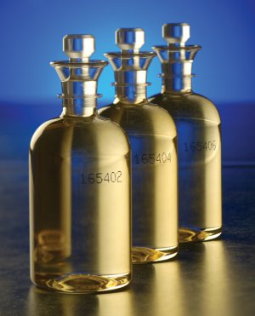
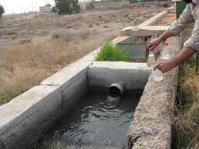
5.1 Biochemical Oxygen Demand (BOD)
BOD₅ Test
Fill airtight bottle
Incubate at specific temperature for 5 days.
Measure DO before and after incubation.
BOD₅ is computed from the difference between initial and final DO.

Slide 7
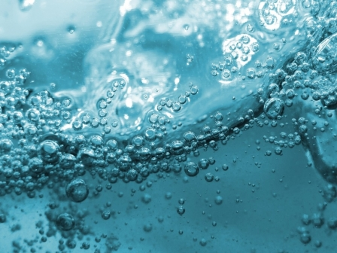
5.2 Dissolved Oxygen (DO)
Stream both produces and consumes O₂;
+ O₂: atmosphere and plants photosynthesis;
O₂ measured in its dissolved form DO;
Best indicators of water ecosystem’s health;
Necessary for good water quality;

Slide 8
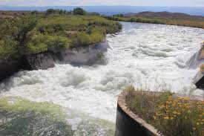
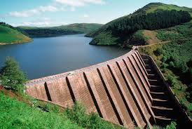
5.2 Dissolved Oxygen (DO)
DO distribution vary due to hydraulic regimes:
⇒ DO reservoirs ≠ rivers;
>DO in running water than still water.

Slide 9
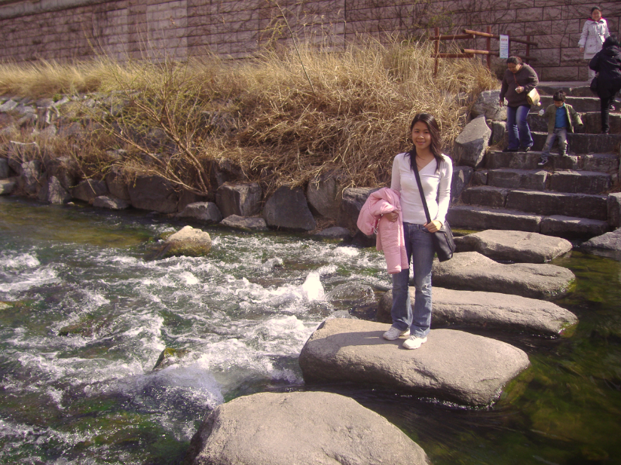
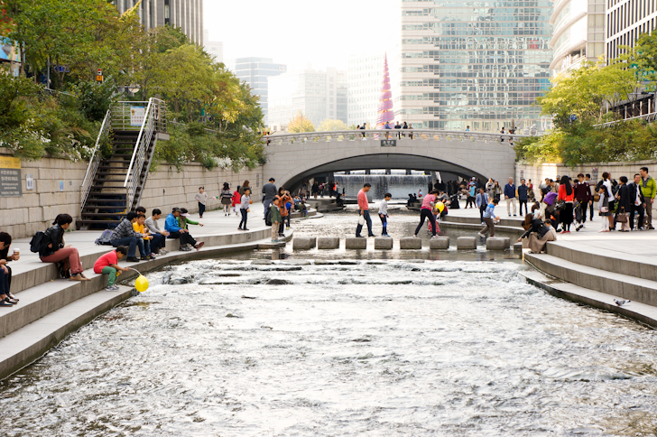
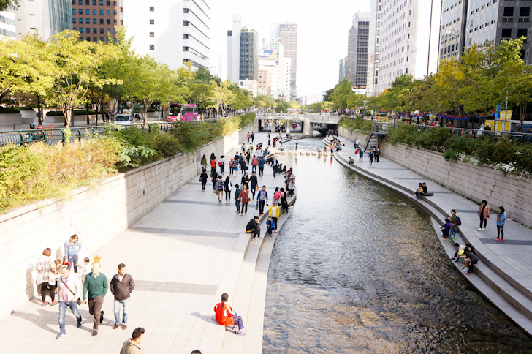
Cheonggyecheon River, South Korea

Slide 10
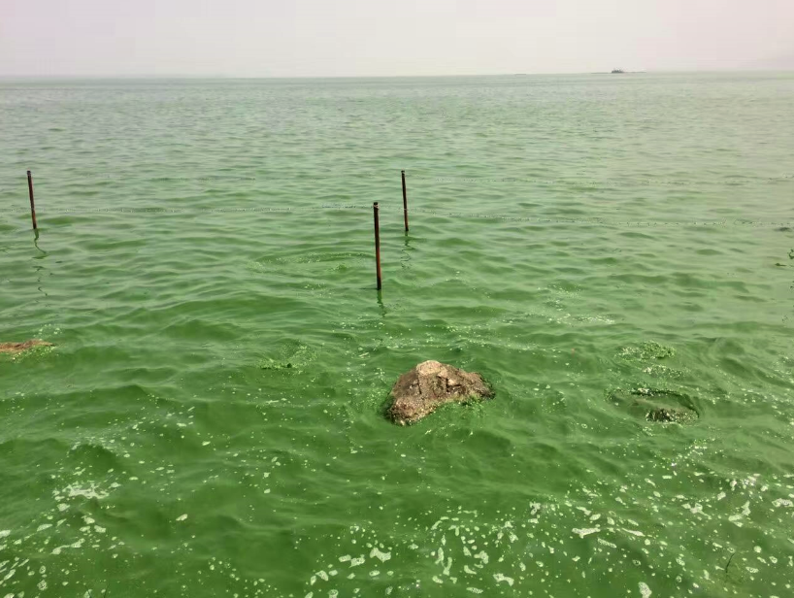

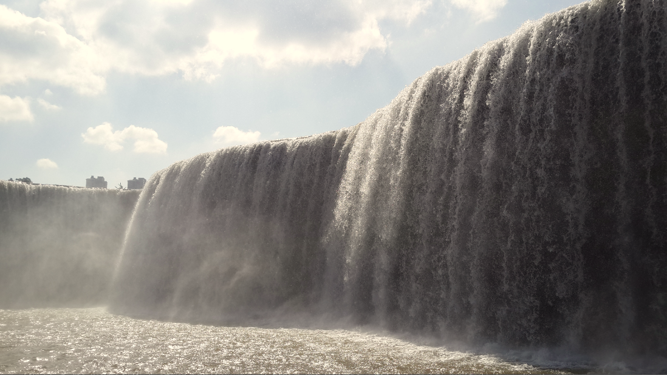
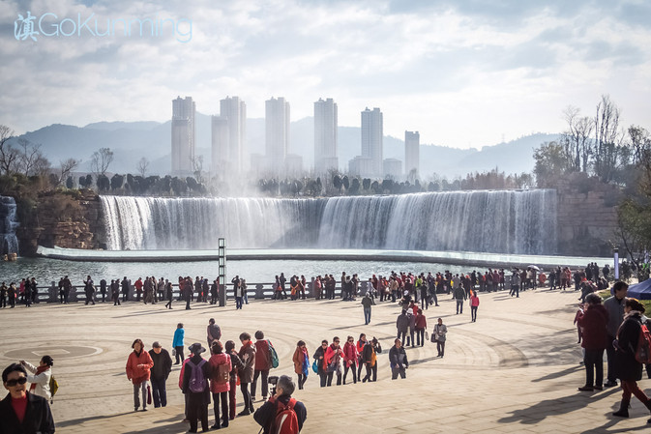
Kunming Waterfall Park, China
Notes:
The waterfall is part of the project diverting water from the Niulan River into Dianchi Lake.

Slide 11
5.2 Dissolved Oxygen (DO)
− O₂: Respiration, decomposition, and various chemical reactions;
If > O₂ is consumed than produced;
DO levels decline;
Sensitive animals may move away/weaken/die;
Fluctuate seasonally and over 24-hour period;
In response to temperature & biological activity;

Slide 12
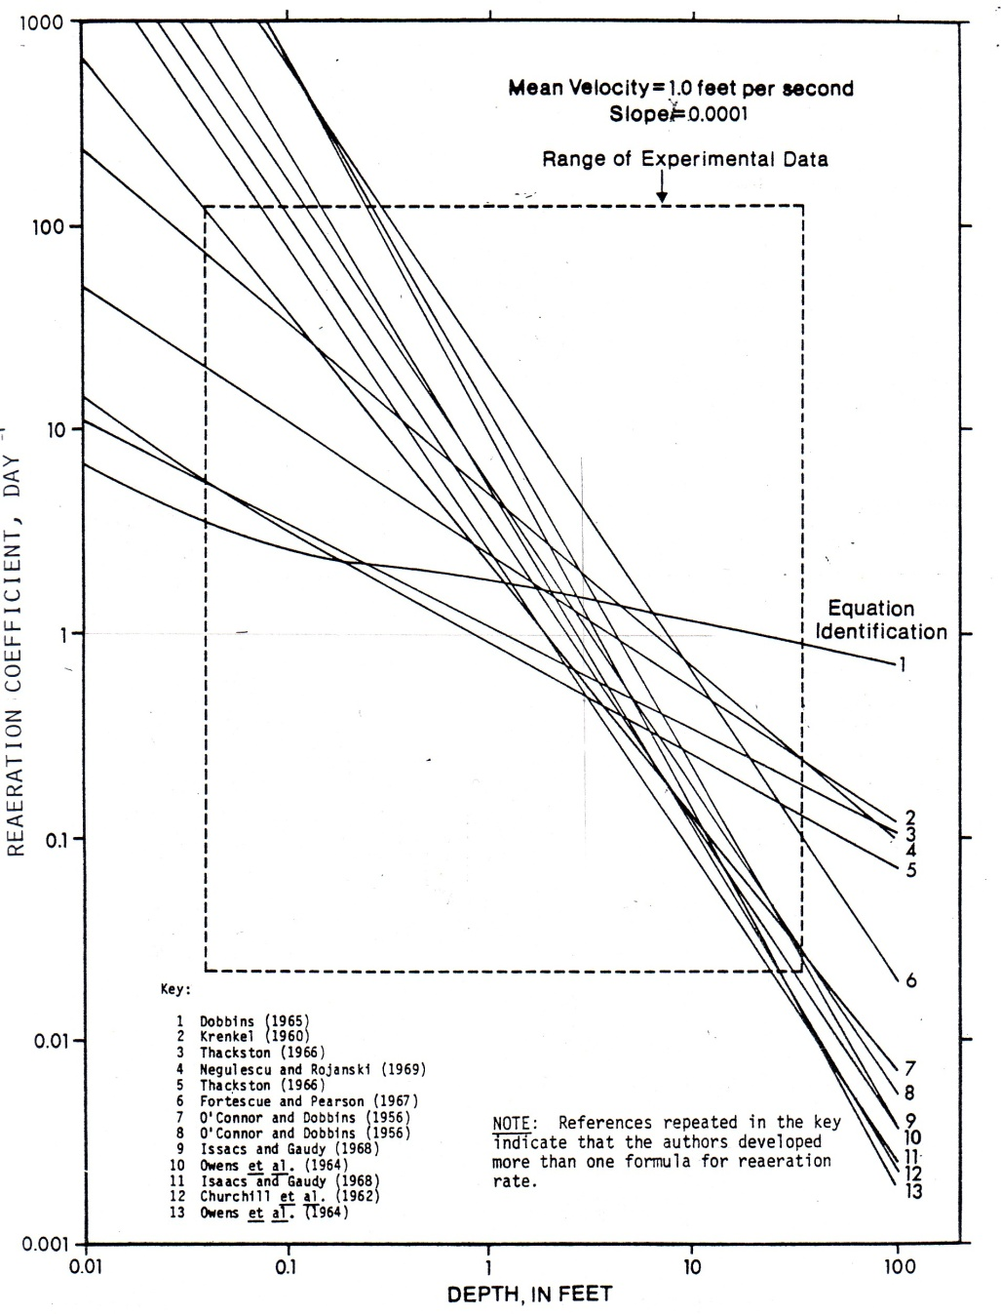
5.2 Dissolved Oxygen (DO)
O₂ solubility is a function of
temperature, salinity, and atmospheric pressure;
O₂ ↓ with ↑ temperature and salinity;
O₂ ↑ with ↑ atmospheric pressure;
Cold water holds more O₂ than warm water;
Water holds less O₂ at higher altitudes.;
Thermal discharges raise the temperature of water and lower its O₂ content.

Slide 13
5.2 Dissolved Oxygen (DO)
↓ DO = indication of pollutant influx;
For maintenance of aquatic health, DO should approach saturation;
Saturation conc is in equilibrium with the partial pressure of atmospheric O₂;
DO >= 7.0 mg/L ⇒ aquatic ecosystem health;
DO < 5.0 mg/L ⇒ stress aquatic life;
↓ DO ⇒ greater the stress.

Slide 14
5.2 Dissolved Oxygen (DO)
O₂ remains below 1-2 mg/L for a few hours can result in large fish kills;
DO can range from 0-18 ppm;
But most natural water systems require 5-6 ppm to support a diverse population;
DO level in good fishing waters generally averages about 9.0 ppm.

Slide 15



5.2 Dissolved Oxygen (DO)
DO (ppm = mg/L) | Water Quality
5-14 | Good. Supports life.
3-5 | Poor. Stressful to many organisms.
0-3 | Bad (hypoxia). Lethal to many organisms.

Slide 16
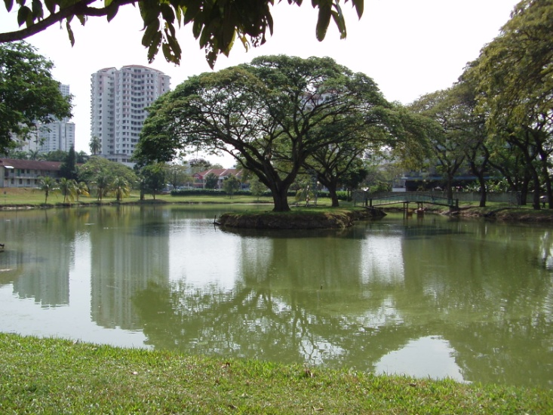
Primary Production
± O₂ = primary production (algae);
Daytime: algal photosynthesis +O₂ > Respiration−O₂;
⇒ DO > saturation level, i.e., super-saturation;
Night time: photosynthesis, algal respiration ↓ DO significantly.

Slide 17
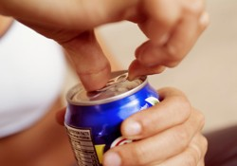
Primary Production
In biologically productive (eutrophic) lakes, DO can become supersaturated;
O₂ is produced by algae or rooted aquatic plants more quickly;
Than it can escape into the atmosphere;
100 percent saturation = DO conc in water is in equilibrium with O₂ in the atmosphere;
When DO conc > 110 percent saturation, harm may come to certain fish.

Slide 18
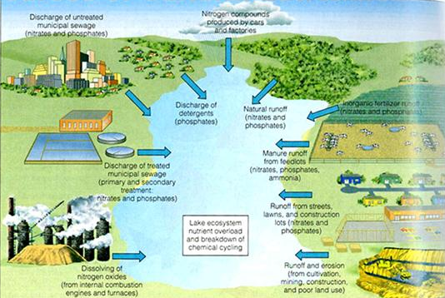
Eutrophication
Occurs when large quantities of nutrients such as nitrates and phosphates enter an aquatic environment.
Sources of these nutrients include animal wastes, agricultural runoff, and sewage.

Slide 19
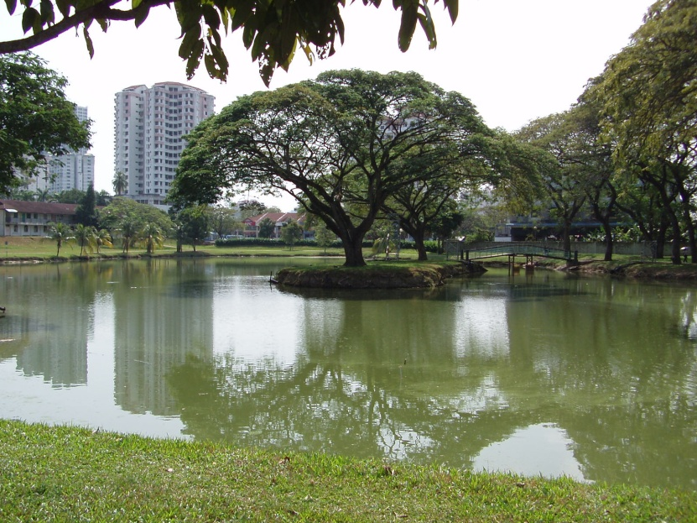
Eutrophication
Ecosystem quickly experiences an increase in photosynthetic and blue-green algae, as these organisms thrive in the presence of the added nutrients.
Eg. Tasik Harapan

Slide 20
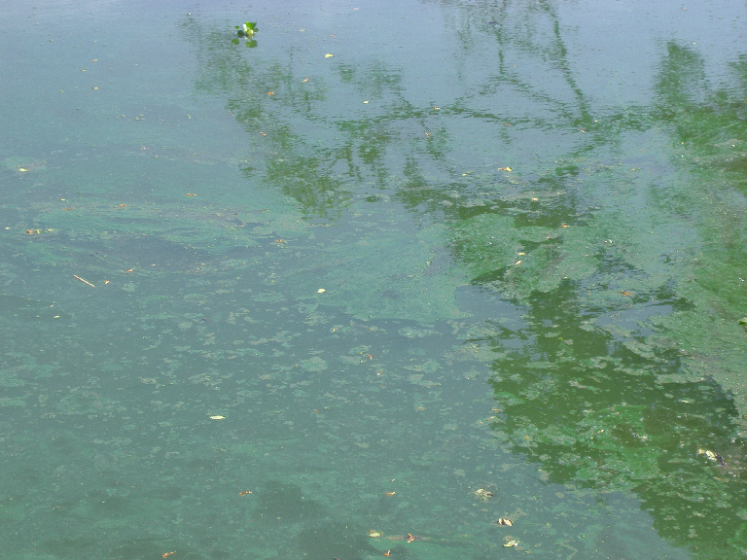
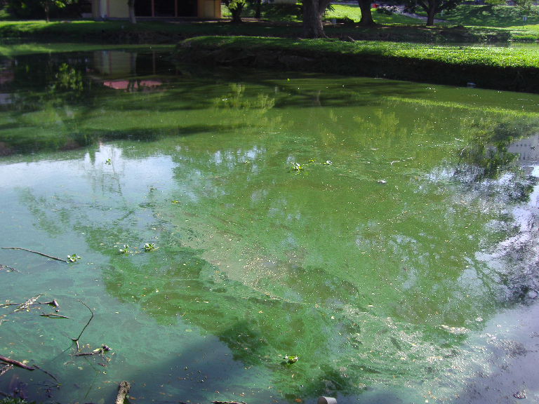
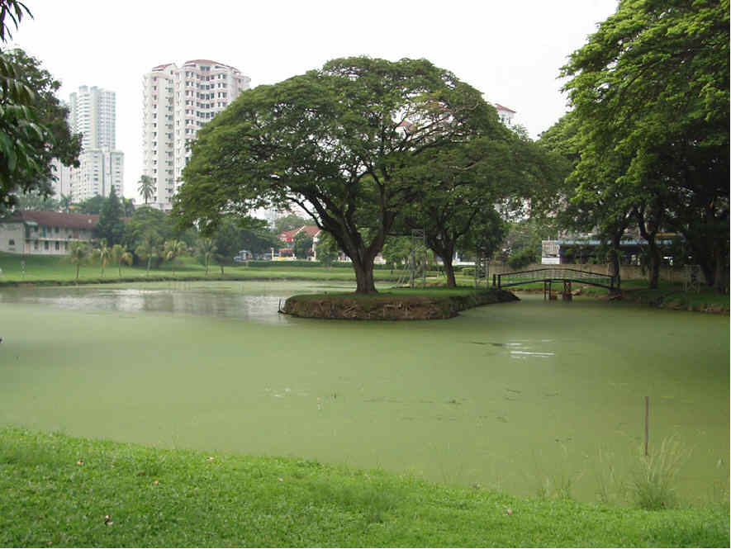
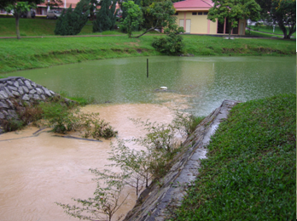
Eutrophication
An algae bloom occurs as the algae accumulates into dense, visible patches near the surface of the water, prohibiting light from penetrating deeper areas of lake or stream.

Slide 21
Eutrophication
Some fish are unable to survive without this light, but for them an even more serious problem arises when the algae begin to die.
At this point, oxygen-demanding bacteria take over the ecosystem, decomposing the algae and using up dissolved oxygen in the process.
These bacteria increase the biological oxygen demand (BOD) of the ecosystem.

Slide 22
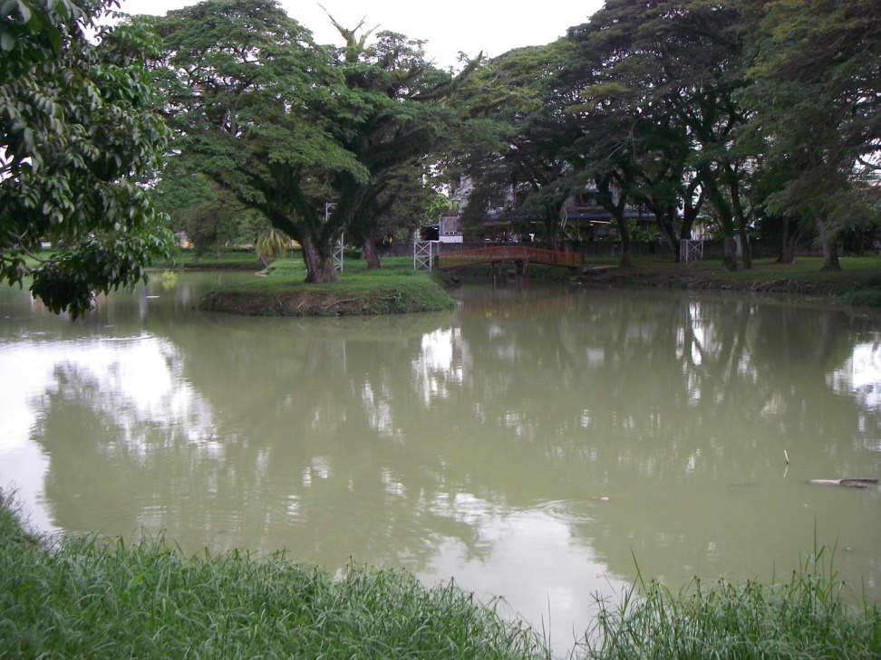
Tasik Harapan 2004-2012

Slide 23
DO in T. Harapan

Slide 24
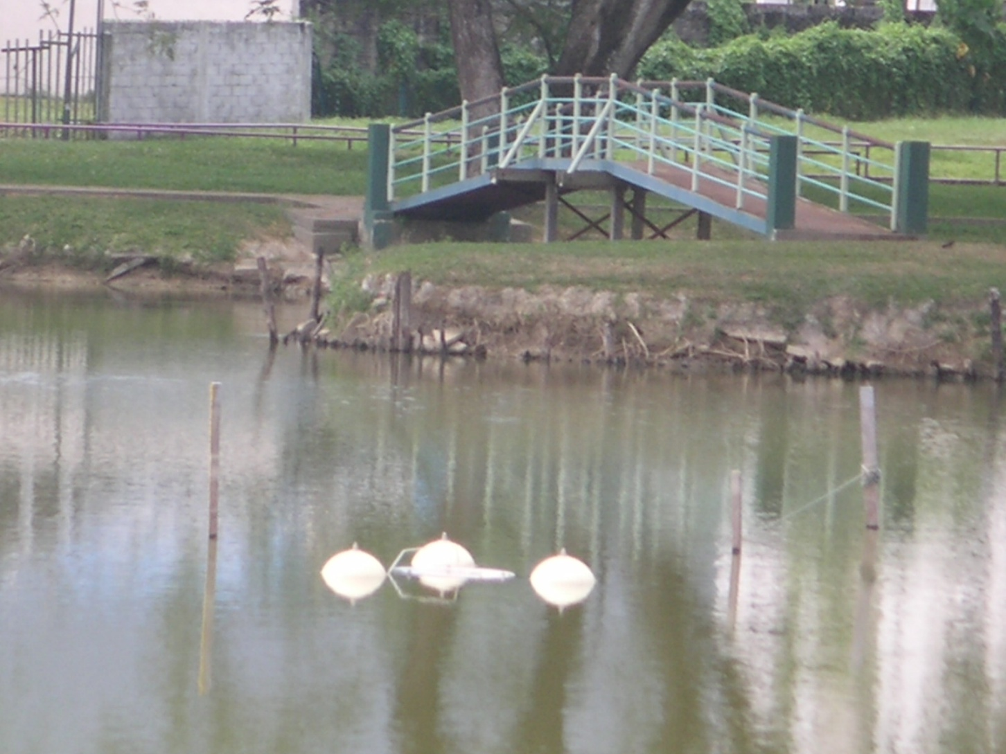
Mechanical Aerator

Slide 25
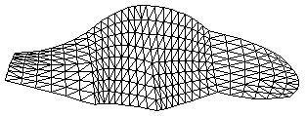
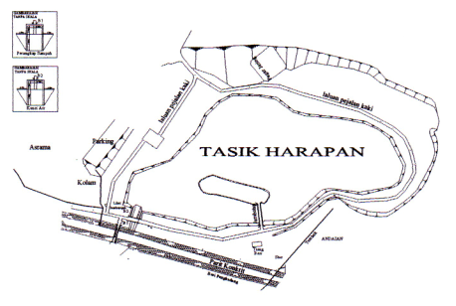
Mechanical Aerator

Slide 26
Aerator effect on DO levels in Tasik Harapan

Slide 27
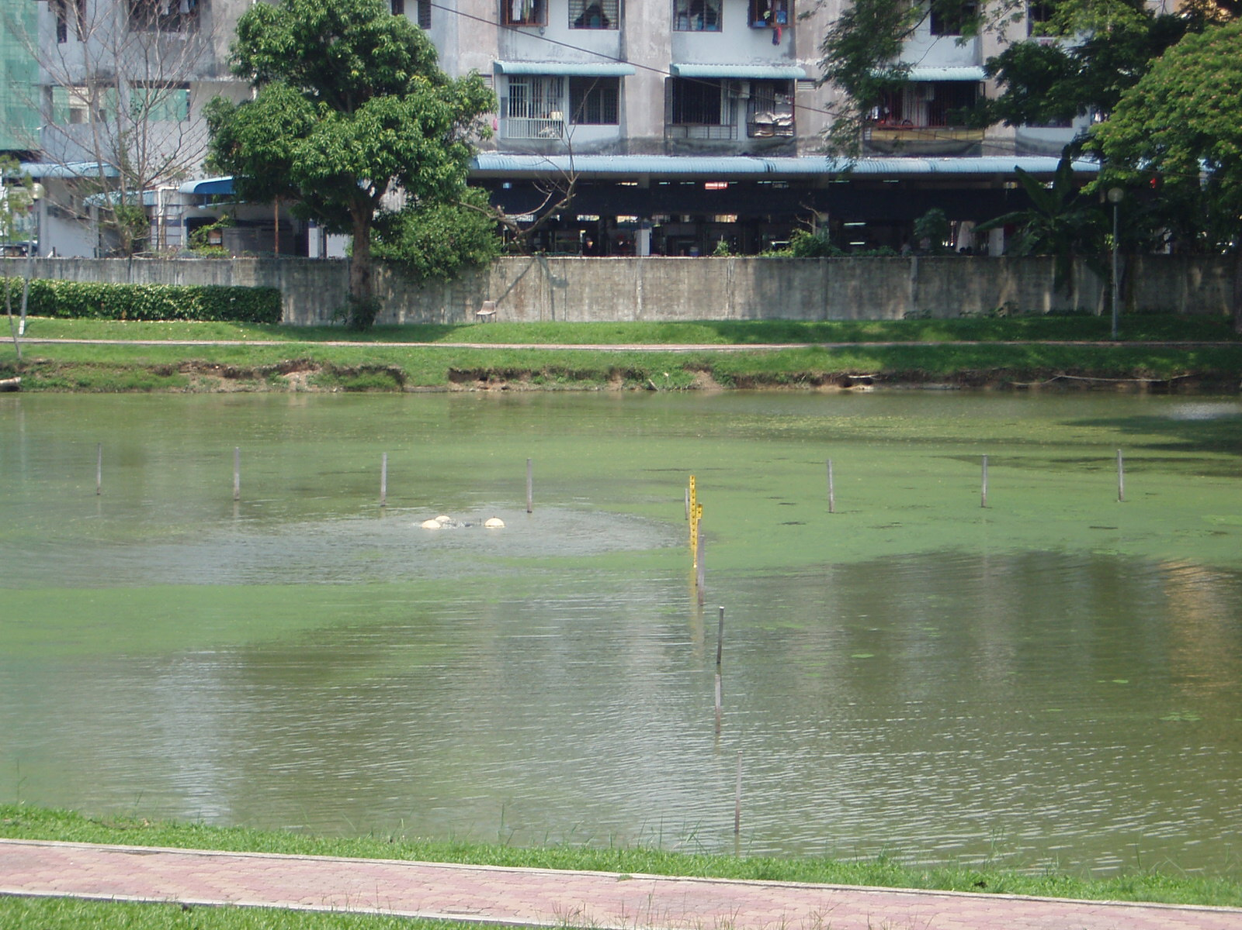
Mechanical Aerator

Slide 28
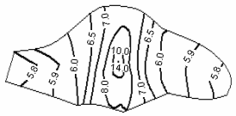
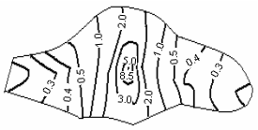
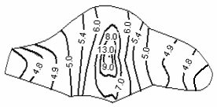
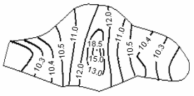
Aerator effect on DO levels in Tasik Harapan
12:00 am
6:00 am
12:00 pm
6:00 pm

Slide 29
Aerator effect on DO levels in Tasik Harapan

Slide 30
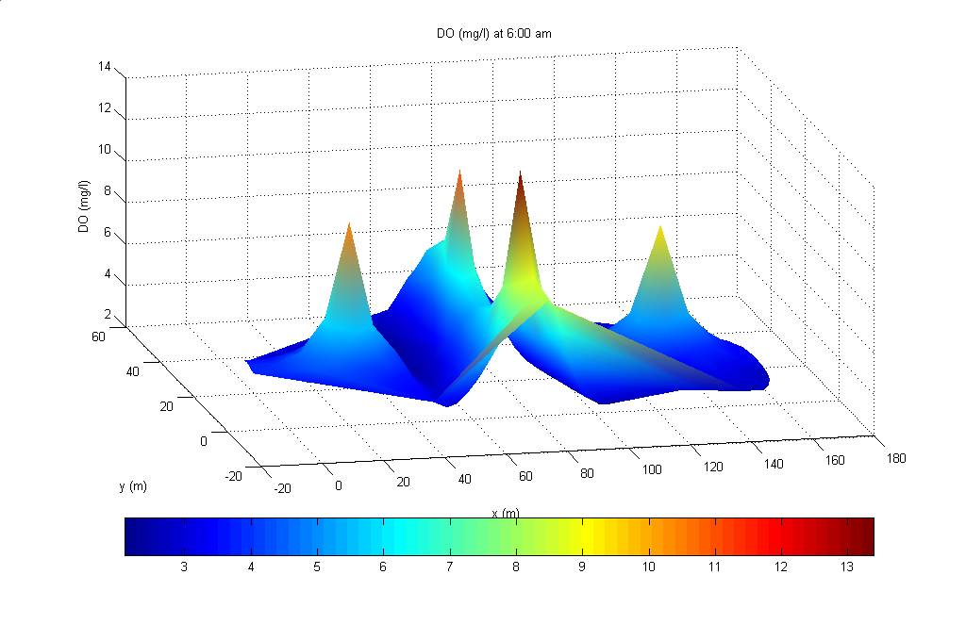
Mechanical Aerator
One aerator
Four aerators

Slide 31
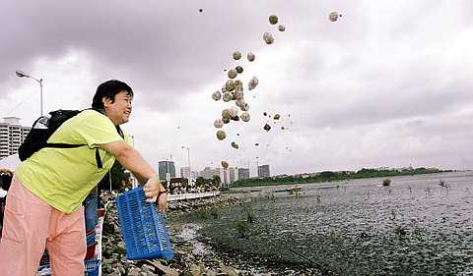
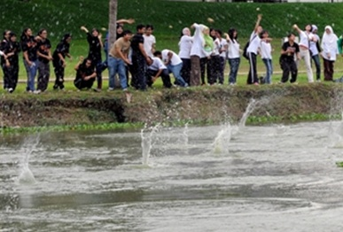
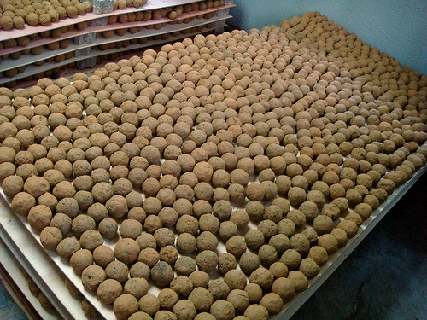
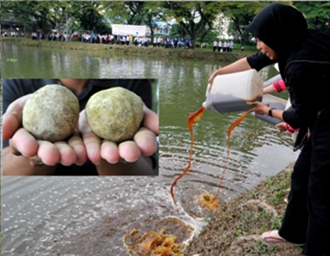
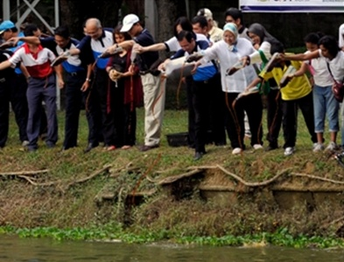
Role of Mudball & EM Solution
Lurling, M., Tolman, Y. and van Oosterhout, F. (2010). Cyanobacteria blooms cannot be controlled by Effective Microorganisms (EM®) from mud- or Bokashi-balls. Hydrobiologia 646, 133–143.

Slide 32
Tasik Harapan
Tasik Harapan is highly eutrophicated;
Wild fluctuation of DO over the diurnal cycle;
Reaching > 18 mg/L in late afternoon;
Mechanical aerator not effective;
Does not remove the source of nutrients;
Adding DO is meaningless in TH;

Slide 33
Tasik Harapan
Mudball and EM solution did not appear to reduce the degree of eutrophication in TH;
Addition of mudballs may even ↑ turbidity;
And add additional nutrients;
Further complicate eutrophication process;
Removal of sediment from the lake bottom;
Viable option that deserves more careful study;

Slide 34
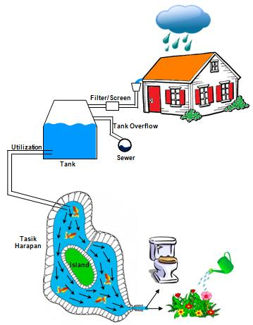
Tasik Harapan
Sediment removal is sustainable in long run;
If a source of water can be found;
In the form of rainwater harvesting;
To provide flow to Tasik Harapan;
Should be closely look at in the near future.

Slide 35
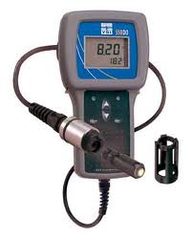
Reaeration
Another mechanism that may ↑ or ↓ DO is transfer through air-water interface;
Typically, transfer is from atmosphere into water (reaeration);
DO in most natural waters is below saturation;
Supersaturated conditions: net transfer of O₂ from water body to atmosphere;
Measurement: DO meter;
Converts signals from a probe into mg/L.

Slide 36
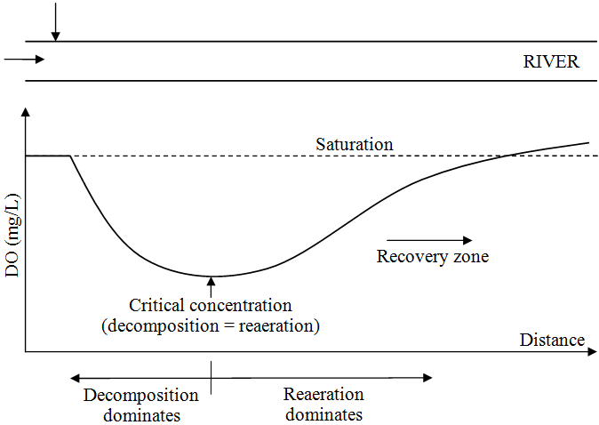
5.2 Dissolved Oxygen (DO)
Introduction of untreated sewage;
Into a stream originally unpolluted;
Will deplete the DO levels in the stream.
Figure 5.1 DO sag that occurs below sewage discharges into streams

Slide 37
5.2 Dissolved Oxygen (DO)
As O₂ ↓, atmospheric oxygen enters water;
To compensate for O₂ deficit;
Initially, O₂ consumption dwarfs reaeration;
As the organic matter assimilated and O₂ drop;
⇒ Depletion & reaeration in balance.

Slide 38
5.2 Dissolved Oxygen (DO)
Lowest or critical level of O₂ = DO sag;
Beyond this point, reaeration dominates;
O₂ levels begin to rise;
Location and magnitude of this critical conc;
Depends on:
loading size,
stream’s flow and morphometry,
temperature, etc.

Slide 39
5.3 Streeter-Phelps Eqn
Streeter-Phelps model: 2 primary mechanisms governing DO in a stream receiving sewage:
decomposition of organic matter;
O₂ reaeration.
1st step in modelling DO sag: characterize the strength of the wastewater;
Focus on the decomposition process;
By measuring the amount of oxygen consumed, i.e. BOD.

Slide 40
5.3 Streeter-Phelps Eqn
BOD oxidation in a uniformly mixed segment is generally written as a first order reaction:
(5.1)

Slide 41
5.3 Streeter-Phelps Eqn
DO mass balance equation :
(5.2)

Slide 42
Reaeration
DO reaeration:

Slide 43
Reaeration
DO reaeration:

Slide 44
5.3 Streeter-Phelps Eqn
Before proceeding to other aspects of BOD-DO modeling, let’s review some of the parameters that relate to BOD-DO.
BOD Decay Rate α
BOD Decay Rate α
BOD Loading γ
DO Saturation c_{s}
Reaeration Rate β

Slide 45
5.3.1 BOD Decay Rate α
BOD bottle decay typical values: 0.05-0.5 d⁻¹;
Mean of about 0.15 d⁻¹;
Info used to estimate a 95 % response time;
For the bottle test as t₉₅ = 3/0.15 = 20 d;
Long measurement period is unacceptable;
Adopt a 5-day BOD (BOD₅) test.

Slide 46
Table 5.1 Typical values of the BOD decomposition rate for various levels of treatment
Treatment | α (d⁻¹) at 20 °C
Untreated | 0.35 (0.20 – 0.50)
Primary | 0.20 (0.10 – 0.30)
Activated sludge | 0.075 (0.05 – 0.10)
Raw sewage = mixture of compounds;
From easily decomposable sugars;
To refractory substances (longer to decay);
Waste treatment selectively remove former;
BOD decay rates is lower for treated sewage.

Slide 47
5.3 Streeter-Phelps Eqn
Before proceeding to other aspects of BOD-DO modelling, let’s review some of the parameters that relate to BOD-DO.
BOD Decay Rate α
BOD Decay Rate α
BOD Loading γ
BOD Loading γ
DO Saturation c_{s}
Reaeration Rate β

Slide 48
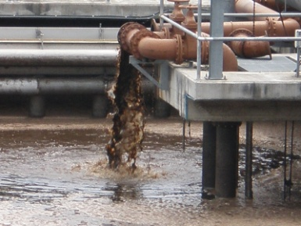
5.3.2 BOD Loading γ
BOD loading (mass/time) = BOD conc of wastewater (effluent) released into a body of water.
Table 5.2 Typical loading rates for untreated domestic sewage
 | Per-capita flow rate (m³ capita⁻¹ d⁻¹) | Per-capita CBOD (m³ capita⁻¹ d⁻¹) | CBOD conc (mg/L)
United States | 0.57 (150)∗ | 125 (0.275)∗∗ | 220
Developing countries | 0.19 (50)∗ | 60 (0.132)∗∗ | 320

Slide 49
Table 5.2 Typical loading rates for untreated domestic sewage
US flow rate ↑ - higher standard of living;
Per capita BOD generation rate ↑ - garbage disposals and other accoutrements of a developed economy;
 | Per-capita flow rate (m³ capita⁻¹ d⁻¹) | Per-capita CBOD (m³ capita⁻¹ d⁻¹) | CBOD conc (mg/L)
United States | 0.57 (150)∗ | 125 (0.275)∗∗ | 220
Developing countries | 0.19 (50)∗ | 60 (0.132)∗∗ | 320

Slide 50
Table 5.2 Typical loading rates for untreated domestic sewage
Average conc in developing countries is generally ↑ - lower water;
↓ water use in developing countries outweighs the higher per capita US BOD contribution.
 | Per-capita flow rate (m³ capita⁻¹ d⁻¹) | Per-capita CBOD (m³ capita⁻¹ d⁻¹) | CBOD conc (mg/L)
United States | 0.57 (150)∗ | 125 (0.275)∗∗ | 220
Developing countries | 0.19 (50)∗ | 60 (0.132)∗∗ | 320

Slide 51
5.3.2 BOD Loading γ
Raw waste from palm oil processing factory;
Before treatment, can reach 30000 mg/L BOD;
Proper treatment ⇒ 300 mg/L or lower;
Department of Environment (DOE);
Receiving Water Quality Criteria for Malaysia in 1985;
Aim: Develop a water quality management approach for the long term water quality of the nation's water resources.

Slide 52
5.3.2 BOD Loading γ
Environment Quality (Sewerage and Industrial Effluents) Regulations 1979 (Revoked by PU(A) 432/2009);
Environment Quality (Industrial Effluents) Regulations 2009;
Environment Quality (Sewage) Regulations 2009;
Standard A : ≤ 20 mg/L BOD;
Standard B : ≤ 50 mg/L BOD;
Effluent discharged upstream of a water supply intake should meet Standard A;
Effluent discharged downstream has to meet Standard B.

Slide 53
Table 5.3a Parameter limits of industrial effluents of Standards A and B
Parameter |  | Unit | Standard
 |  |  | A | B
1 | Temperature | ºC | 40 | 40
2 | pH Value | - | 6.0-9.0 | 5.5-9.0
3 | BOD at 20ºC | mg/L | 20 | 50
4 | Suspended Solids | mg/L | 50 | 100
5 | Mercury | mg/L | 0.005 | 0.05
6 | Cadmium | mg/L | 0.01 | 0.02
7 | Chromium, Hexavalent | mg/L | 0.05 | 0.05
8 | Chromium, Trivalent | mg/L | 0.20 | 1.0
9 | Arsenic | mg/L | 0.05 | 0.10
10 | Cyanide | mg/L | 0.05 | 0.10
11 | Lead | mg/L | 0.10 | 0.5
12 | Copper | mg/L | 0.20 | 1.0
13 | Manganese | mg/L | 0.20 | 1.0
14 | Nickel | mg/L | 0.20 | 1.0
15 | Tin | mg/L | 0.20 | 1.0
Parameter |  | Unit | Standard
 |  |  | A | B
16 | Zinc | mg/L | 2.0 | 2.0
17 | Boron | mg/L | 1.0 | 4.0
18 | Iron (Fe) | mg/L | 1.0 | 5.0
19 | Silver | mg/L | 0.1 | 1.0
20 | Aluminium | mg/L | 10 | 15
21 | Selenium | mg/L | 0.02 | 0.5
22 | Barium | mg/L | 1.0 | 2.0
23 | Fluoride | mg/L | 2.0 | 5.0
24 | Formaldehyde | mg/L | 1.0 | 2.0
25 | Phenol | mg/L | 0.001 | 1.0
26 | Free Chlorine | mg/L | 1.0 | 2.0
27 | Sulphide | mg/L | 0.50 | 0.50
28 | Oil and Grease | mg/L | 1.0 | 10
29 | Ammoniacal Nitrogen | mg/L | 10 | 20
30 | Colour | ADMI* | 100 | 200
*ADMI-American Dye Manufacturers Institute

Slide 54
Table 5.3b COD limits of industrial effluents of Standards A and B
Unit | Standard
 | A | B
mg/L | 80 | 200
Trade/Industry | Unit | Standard
 |  | A | B
(a) Pulp and paper industry
(i) pulp mill | mg/L | 80 | 350
(ii) paper mill (recycled) | mg/L | 80 | 250
(iii) pulp and paper mill | mg/L | 80 | 300
(b) Textile industry | mg/L | 80 | 250
(c) Fermentation and distillery industry | mg/L | 400 | 400
(d) Other industries | mg/L | 80 | 200

Slide 55
Table 5.3a Parameter limits of sewerage effluents of Standards A and B
Parameter |  | Unit | Standard
 |  |  | A | B
1 | Temperature | ºC | 40 | 40
2 | pH Value | - | 6.0-9.0 | 5.5-9.0
3 | BOD5 at 20°C | mg/L | 20 | 50
4 | COD | mg/L | 120 | 200
5 | Suspended Solids | mg/L | 50 | 100
6 | Oil and Grease | mg/L | 5.0 | 10.0
7 | Ammoniacal Nitrogen (enclosed water body) | mg/L | 5.0 | 5.0
8 | Ammoniacal Nitrogen (river) | mg/L | 10.0 | 20.0
9 | Nitrate - Nitrogen (river) | mg/L | 20.0 | 50.0
10 | Nitrate - Nitrogen (enclosed water body) | mg/L | 10.0 | 10.0
11 | Phosphorous (enclosed water body) | mg/L | 5.0 | 10.0
*New sewage treatment system

Slide 56
5.3 Streeter-Phelps Eqn
Before proceeding to other aspects of BOD-DO modelling, let’s review some of the parameters that relate to BOD-DO.
BOD Decay Rate α
BOD Loading γ
BOD Loading γ
DO Saturation c_{s}
DO Saturation c_{s}
Reaeration Rate β

Slide 57
5.3.3 DO Saturation c_{s}
c_{s} = O₂ saturation constant;
Highest DO conc achieved under certain circumstances;
Several env factors affect DO saturation:
temperature, salinity and partial pressure variations due to elevation.
Several empirical derived equations have been developed to predict how these factors influence saturation.

Slide 58
5.3.3 DO Saturation c_{s}
Temp °C | Salinity (ppt)
 | 0 | 5 | 10 | 15 | 20 | 25 | 30 | 35
0 | 14.60 | 14.11 | 13.64 | 13.18 | 12.74 | 12.31 | 11.90 | 11.50
2 | 13.81 | 13.36 | 12.91 | 12.49 | 12.07 | 11.67 | 11.29 | 10.91
4 | 13.09 | 12.67 | 12.25 | 11.85 | 11.47 | 11.09 | 10.73 | 10.38
6 | 12.44 | 12.04 | 11.65 | 11.27 | 10.91 | 10.56 | 10.22 | 9.89
8 | 11.83 | 11.46 | 11.09 | 10.74 | 10.4 | 10.07 | 9.75 | 9.44
10 | 11.28 | 10.92 | 10.58 | 10.25 | 9.93 | 9.62 | 9.32 | 9.03
12 | 10.77 | 10.43 | 10.11 | 9.80 | 9.50 | 9.21 | 8.92 | 8.65
14 | 10.29 | 9.98 | 9.68 | 9.38 | 9.1 | 8.82 | 8.55 | 8.29
16 | 9.86 | 9.56 | 9.28 | 9.00 | 8.73 | 8.47 | 8.21 | 7.97
18 | 9.45 | 9.17 | 8.90 | 8.64 | 8.38 | 8.14 | 7.90 | 7.66
20 | 9.08 | 8.81 | 8.56 | 8.31 | 8.06 | 7.83 | 7.60 | 7.38
22 | 8.73 | 8.48 | 8.23 | 8.00 | 7.77 | 7.54 | 7.33 | 7.12
24 | 8.40 | 8.16 | 7.93 | 7.71 | 7.49 | 7.28 | 7.07 | 6.87
26 | 8.09 | 7.87 | 7.65 | 7.44 | 7.23 | 7.03 | 6.83 | 6.64
28 | 7.81 | 7.59 | 7.38 | 7.18 | 6.98 | 6.79 | 6.61 | 6.42
30 | 7.54 | 7.33 | 7.14 | 6.94 | 6.75 | 6.57 | 6.39 | 6.22

Slide 59
5.3 Streeter-Phelps Eqn
Before proceeding to other aspects of BOD-DO modelling, let’s review some of the parameters that relate to BOD-DO.
BOD Decay Rate α
BOD Loading γ
DO Saturation c_{s}
DO Saturation c_{s}
Reaeration Rate β
Reaeration Rate β

Slide 60
5.3.4 Reaeration Rate β
Many investigators have developed formulas;
For predicting reaeration in streams and rivers;
Comprehensive reviews (Bennett and Rathbun, 1972; Bowie et al., 1985; USEPA, 1985);
For standing waters, e.g. lakes, impoundments and wide estuaries, wind becomes the predominant factor in causing reaeration.

Slide 61
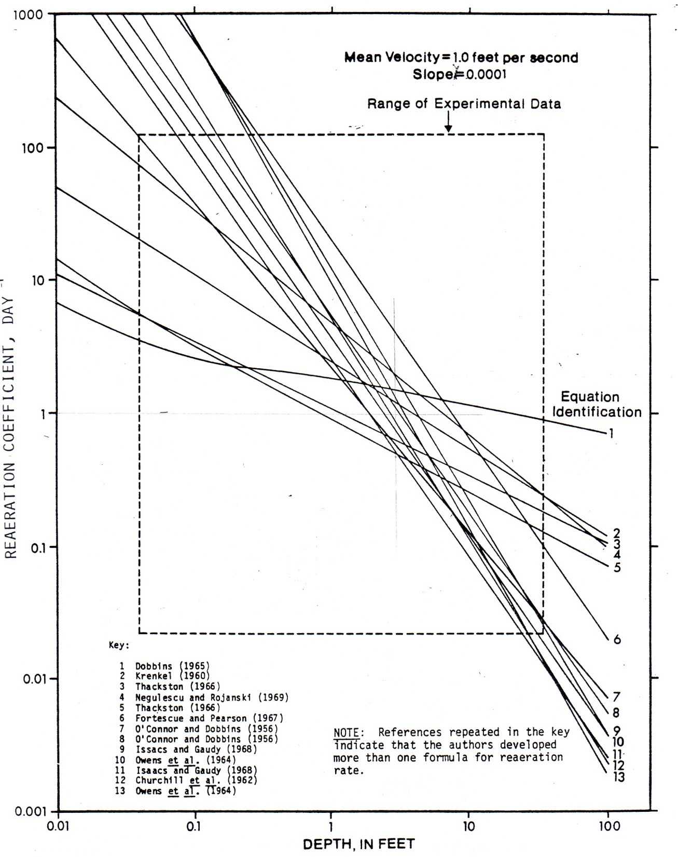
USEPA Reaeration β Estimation

Slide 62
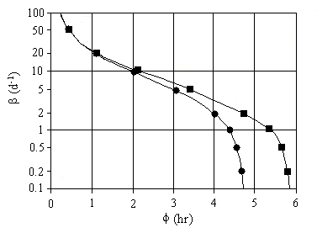
Delta Method β Estimation
(ii) atan (σ/β)
(i) Delta

Slide 63
5.4 Interim National River WQ Standards
WQ data were used to determine WQ status;
Rivers in Malaysia;
Status: Clean, slightly polluted or polluted;
River classification: Class I, II, III, IV or V;
Based upon Water Quality Index (WQI) and Interim National Water Quality Standards for Malaysia (INWQS).

Slide 64
5.4 Interim National River WQ Standards
WQI is computed based upon 6 main parameters as follows.
Biochemical Oxygen Demand (BOD)
Chemical Oxygen Demand (COD)
Ammoniacal Nitrogen (NH₃N)
pH
Dissolved Oxygen (DO)
Suspended Solids (SS)
Other parameters, e.g. heavy metals and bacteria, according to site requirement.

Slide 65
Table 5.4 Classification of rivers in Malaysia
Class | Use
Class I | Conservation of natural environment, Water Supply I – practically no treatment necessary, Fishery I – very sensitive aquatic species.
Class IIA | Water supply II – conventional treatment required, Fishery II – sensitive aquatic species.
Class IIB | Recreational use with body contact
Class III | Water supply III – extensive treatment required, Fishery III – common, of economic value, and tolerant species livestock drinking
Class IV | Irrigation
Class V | None of the above

Slide 66
Table 5.4 Interim National Water Quality Standards for Malaysia
Parameter | Unit | Classes
 |  | I | IIA | IIB | III | IV | V
Ammoniacal Nitrogen | mg/L | 0.1 | 0.3 | 0.3 | 0.9 | 2.7 | >2.7
BOD | mg/L | 1 | 3 | 3 | 6 | 12 | >12
COD | mg/L | 10 | 25 | 25 | 50 | 100 | >100
DO | mg/L | 7 | 5-7 | 5-7 | 3-5 | <3 | <1
pH |  | 6.5-8.5 | 6-9 | 6-9 | 5-9 | 5-9 | −
Colour | TCU | 15 | 150 | 150 | − | − | −
Elec. Conductivity* | Umhos/cm | 1000 | 1000 | − | − | 6000 | −
Floatables |  | N | N | N | − | − | −
Odour |  | N | N | N | − | − | −
Salinity (%) | % | 0.5 | 1 | − | − | 2 | −
Taste |  | N | N | N | − | − | −
Total Dissolved Solid | mg/L | 500 | 1000 | − | − | 4000 | −
Total Suspended Solid | mg/L | 25 | 50 | 50 | 150 | 300 | 300
Temperature (C) | °C | − | Normal +2 °C | − | Normal +2 °C | − | −
Turbidity (NTU) | NTU | 5 | 50 | 50 | − | − | −
Faecal Coliform** | counts/100mL | 10 | 100 | 400 | 5000 (20000)ª | 5000 (20000)ª | −
Total Coliform | counts/100mL | 100 | 5000 | 5000 | 50000 | 50000 | >50000
Parameter | Unit | Classes
 |  | I | IIA | IIB | III | IV | V
BOD | mg/L | 1 | 3 | 3 | 6 | 12 | >12
DO | mg/L | 7 | 5-7 | 5-7 | 3-5 | <3 | <1

Slide 67
5.5 BOD-DO Dynamics
BOD-DO model formed based upon mass balance principles;
As a result of various processes involved;
And sources and sinks that influence conc;
BOD sources: industrial waste, domestic sewage and runoff from agriculture or rain;
DO loss is caused by various processes;
BOD oxidation and aquatic plant respiration.

Slide 68
5.5 BOD-DO Dynamics
BOD and DO conc are also influenced by hydraulic processes;
E.g. advective flow and dispersion;
Simplification: Photosynthesis and respiration processes assumed to cancel out each other;
Hence, both processes are omitted from the mass balance equation.

Slide 69
BOD-DO Model
(5.1)
(5.2)

Slide 70
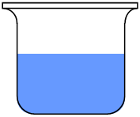
5.5.1 Closed Bottle
Consider BOD oxidation in a closed bottle:
X
BOD:
X
(5.1a)
(5.1)
Solution:
(5.3)
Figure 5.2 A closed bottle

Slide 71
5.5.1 Closed Bottle
BOD oxidizes ⇒ DO will be reduced;
Deoxygenate 1 mg BOD=Eliminate 1 mg DO.
X
DO:
X
(5.2)
(5.2a)
Solution:
Figure 5.2 A closed bottle

Slide 72
Figure 5.3 BOD and DO levels in a closed bottle
Case (a) : Initial DO > initial BOD.

Slide 73
Figure 5.3 BOD and DO levels in a closed bottle
Case (b) : Initial DO < initial BOD.

Slide 74
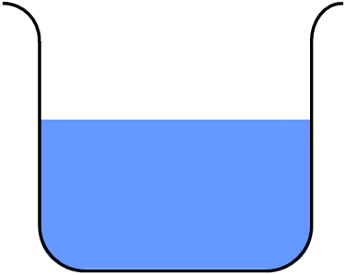
5.5.1 Opened Bottle
(5.1a)
(5.2a)
(5.2)
(5.5)
D = DO deficit
Figure 5.4 An opened bottle

Slide 75
5.5.1 Opened Bottle
(5.5)
(5.5)
(5.2)
Differentiate with respect to t
(5.6)
(5.6)
Substitute into (5.2)
(5.1a)
(5.7)
Eqns (5.1a) and (5.7): change in BOD and DO (deficit) in the opened bottle;
Use of deficit simplifies differential equation.

Slide 76
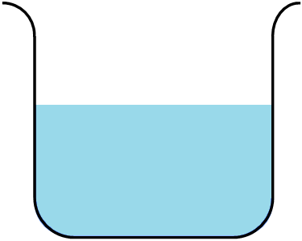
Zero Initial BOD
Clean water;
Subject to only reaeration.
DO Deficit:
(5.7a)
Solution:
(5.8)
(5.9)

Slide 77
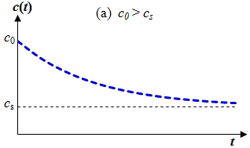
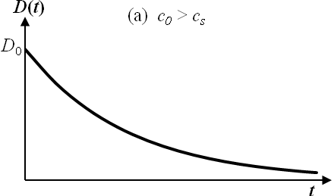
Figure 5.5 DO concentration and DO deficit in an opened bottle
Case (a) : Initial DO > DO Saturation.
DO Deficit increases exponentially to c_{s};
DO decreases exponentially to c_{s};
t → ∞ ⇒ c(t) → c_{s}, D(t) → 0;

Slide 78
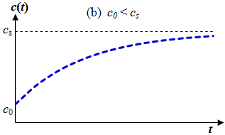
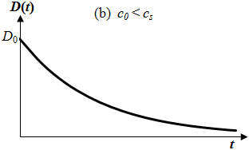
Figure 5.5 DO concentration and DO deficit in an opened bottle
Case (b) : Initial DO < DO Saturation.
DO Deficit decreases exponentially to zero;
DO increases exponentially to c_{s};
t → ∞ ⇒ c(t) → c_{s}, D(t) → 0;

Slide 79
Non-zero Initial BOD
Polluted water;
DO: ↓BOD decay + ↑reaeration.
(5.7)
Solution:
(5.10)
(5.11)

Slide 80
Non-zero Initial BOD
(5.3)
(5.10)
or
(5.11)

Slide 81
Figure 5.6 BOD, DO and DO deficit in the opened bottle

Slide 82
Critical Time and Value
Critical value c_{c} : minimum DO value;
critical DO deficit D_{c} ;
Critical time t_{c} : time when DO is minimum.
maximum
(5.10)
(5.7)
(5.12)
Differentiate
Set dD/dt = 0
Set dD/dt = 0
(5.13)
(5.12)
(5.13)

Slide 83
Critical Time
(5.10)
Differentiate D(t) with respect to t
Set dD/dt = 0
(5.13)

Slide 84
Critical Value
(5.7)
Set dD/dt = 0
(5.13)

Slide 85
Example 5.1
A bottle opened to reaeration and filled with polluted water has the following characteristics:
Find and c(t) after
(a) 1/3 × 10⁴ s; (b) 5/3 × 10⁴ s; (c) 1/3 × 10⁵ s.
Also, find the critical time t_{c}, critical DO deficit D_{c} and critical DO c_{c}.

Slide 86
Example 5.1 – Solution
First, list the relevant equations:
Find and c(t) after
(a) 1/3 × 10⁴ s;
(b) 5/3 × 10⁴ s;
(c) 1/3 × 10⁵ s.
Also, find the critical time t_{c}, critical DO deficit D_{c} and critical DO c_{c}.

Slide 87
Example 5.1 – Solution
(a) After 1/3 × 10⁴ s

Slide 88
Example 5.1 – Solution
(b) After 5/3 × 10⁴ s
Equation (5.12) :
Equation (5.13) :
(c) After 1/3 × 10⁵ s

Slide 89

5.6 BOD-DO Model for River
Determined by considering hydrological processes;
E.g. advective flow and dispersion;
In addition to deoxygenation and reaeration;
Finite segment method discussed in Chapter 3 can be employed for this purpose.

Slide 90
5.6 BOD-DO Model for River
Mass balance eqn for BOD in segment i :
Advective flow
Dispersion
(5.14)
Reaction
Mass balance eqn for DO in segment i :
Advective flow
Dispersion
Reaction
(5.15)

Slide 91


5.6 BOD-DO Model for River
(5.16)

Slide 92

5.6 BOD-DO Model for River

Slide 93
5.6 BOD-DO Model for River
When Δx → 0;
Eqns (5.14) and (5.15) become:
Assume E = 0, W = 0
0
(5.17)
Assume steady-state
(5.19)
0
(5.18)
(5.20)

Slide 94
5.6 BOD-DO Model for River
(5.19)
(5.20)
(5.21)
(5.22)
(5.23)

Slide 95
Example 5.2
A uniform river has a velocity of u = 0.3 m/s and other characteristics as follows:
At x = 0 km, BOD and DO concentrations are:
Find and c(x) at (a) x = 1 km; (b) x = 5 km; (c) x = 10 km. Also, find the critical time t_{c}, critical DO deficit D_{c} and critical DO c_{c}. Sketch the graph of and c(x).

Slide 96
Example 5.2 – Solution
The relation x = ut with u = 0.3 m/s are used here. Hence, x = 1 km is equivalent to t = 1/3 × 10⁴ s. Thus, all equations used in Example 5.1 are used here with x = 0.3t.
This means that the answers here are similar to the answers in Example 5.1 with x = ut and u = 0.3 m/s .

Slide 97
Example 5.2 – Solution
Figure 5.7 BOD and DO concentrations versus time for Example 5.1
Figure 5.8 BOD and DO concentrations versus distance for Example 5.2

Slide 98

Thank You

